Slide 1
Bank Loan Case Study
( PROJECT – 6 )
- BY HITISHA SONI

Slide 2
Project Description :-
Imagine you're a data analyst at a finance company that specializes in lending various
types of loans to urban customers.
Your company faces a challenge: some customers who don't have a sufficient credit history take advantage of this and default on their loans.
Your task is to use Exploratory Data Analysis (EDA) to analyze patterns in the data and ensure that capable applicants are not rejected.

Slide 3
Approach :-
We have given a 2 huge datasets containing 49,999 rows.
application_data
previous_application

Slide 4
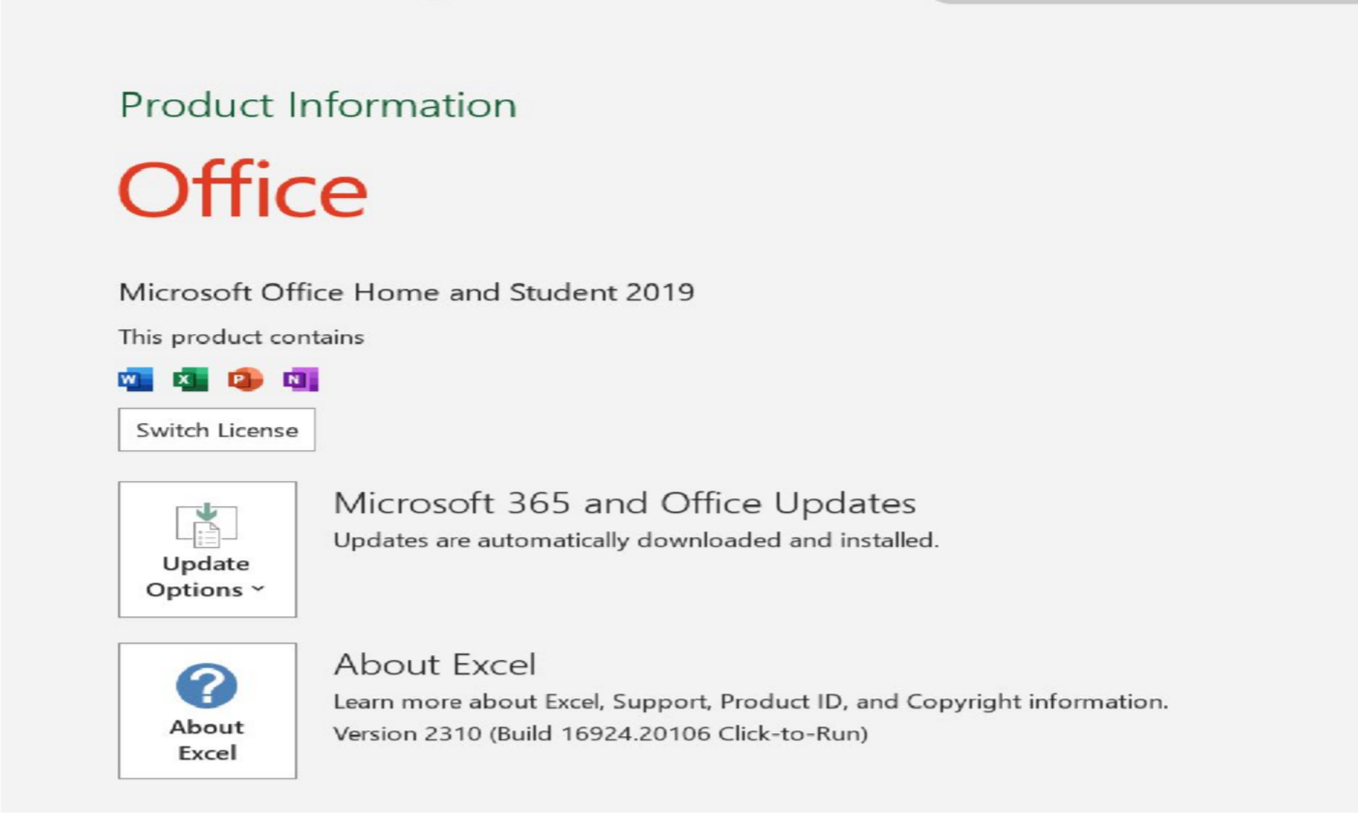
Tech-Stack Used:-

Slide 5
Tasks: Firstly on
Link for application_data file

Slide 6
A. Identify Missing Data and Deal with it Appropriately: As a data analyst, you come across missing data in the loan application dataset. It is essential to handle missing data effectively to ensure the accuracy of the analysis.
Task: Identify the missing data in the dataset and decide on an appropriate method to deal with it using Excel built-in functions and features.

Slide 7

In this, I have removed all the columns which has null percent more than 35% & replaced missing values with average and median
% of null values
80
70
60
50
40
30
20
10
0
AMT_ANNUITY
AMT_GOODS_PRICE NAME_TYPE_SUITE OWN_CAR_AGE OCCUPATION_TYPE CNT_FAM_MEMBERS EXT_SOURCE_1 EXT_SOURCE_2 EXT_SOURCE_3 APARTMENTS_AVG BASEMENTAREA_AVG
YEARS_BEGINEXPLUATATION_AVG
YEARS_BUILD_AVG COMMONAREA_AVG ELEVATORS_AVG ENTRANCES_AVG FLOORSMAX_AVG FLOORSMIN_AVG LANDAREA_AVG LIVINGAPARTMENTS_AVG
LIVINGAREA_AVG NONLIVINGAPARTMENTS_AVG NONLIVINGAREA_AVG APARTMENTS_MODE BASEMENTAREA_MODE YEARS_BEGINEXPLUATATION_MODE
YEARS_BUILD_MODE COMMONAREA_MODE ELEVATORS_MODE ENTRANCES_MODE FLOORSMAX_MODE FLOORSMIN_MODE LANDAREA_MODE LIVINGAPARTMENTS_MODE LIVINGAREA_MODE NONLIVINGAPARTMENTS_MODE NONLIVINGAREA_MODE APARTMENTS_MEDI BASEMENTAREA_MEDI YEARS_BEGINEXPLUATATION_MEDI
YEARS_BUILD_MEDI COMMONAREA_MEDI ELEVATORS_MEDI ENTRANCES_MEDI FLOORSMAX_MEDI FLOORSMIN_MEDI LANDAREA_MEDI LIVINGAPARTMENTS_MEDI
LIVINGAREA_MEDI NONLIVINGAPARTMENTS_MEDI NONLIVINGAREA_MEDI FONDKAPREMONT_MODE HOUSETYPE_MODE TOTALAREA_MODE WALLSMATERIAL_MODE EMERGENCYSTATE_MODE OBS_30_CNT_SOCIAL_CIRCLE DEF_30_CNT_SOCIAL_CIRCLE OBS_60_CNT_SOCIAL_CIRCLE DEF_60_CNT_SOCIAL_CIRCLE DAYS_LAST_PHONE_CHANGE AMT_REQ_CREDIT_BUREAU_HOUR AMT_REQ_CREDIT_BUREAU_DAY AMT_REQ_CREDIT_BUREAU_WEEK AMT_REQ_CREDIT_BUREAU_MON AMT_REQ_CREDIT_BUREAU_QRT AMT_REQ_CREDIT_BUREAU_YEAR

Slide 8
B. Identify Outliers in the Dataset: Outliers can significantly impact the analysis and distort the results. You need to identify outliers in the loan application dataset.
Task: Detect and identify outliers in the dataset using Excel statistical functions and features, focusing on numerical variables.

Slide 9

Outlier for AMT_ANNUITY
Outlier for AMT_INCOME_TOTAL
140000000
300000
120000000
250000
100000000
200000
80000000
150000
60000000
100000
40000000
20000000
50000
0
0
0
0.2
0.4
0.6
0.8
1
1.2
0
0.2
0.4
0.6
0.8
1
1.2

Slide 10

Outlier for CNT_CHILDREN
Outlier for DAYS_EMPLOYED(Years)
12
1200
10
1000
8
800
6
600
4
400
2
200
0
0
0
0.2
0.4
0.6
0.8
1
1.2
0
0.2
0.4
0.6
0.8
1
1.2

Slide 11
C. Analyze Data Imbalance: Data imbalance can affect the accuracy of the analysis, especially for binary classification problems. Understanding the data distribution is crucial for building reliable models.
Task: Determine if there is data imbalance in the loan application dataset and calculate the ratio of data imbalance using Excel functions.

Slide 12
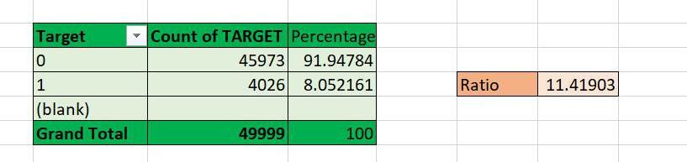



Data Imbalance
50000
45973
45000
40000
35000
30000
25000
Total
20000
15000
10000
5000
4026
0
0
1
(blank)

Slide 13
D. Perform Univariate, Segmented Univariate, and Bivariate Analysis: To gain insights into the driving factors of loan default, it is important to conduct various analyses on consumer and loan attributes.
Task: Perform univariate analysis to understand the distribution of individual variables, segmented univariate analysis to compare variable distributions for different scenarios, and bivariate analysis to explore relationships between variables and the target variable using Excel functions and features.

Slide 14



Univariate analysis
Total
14000
13105
12000
10782
10000
8000
Total
5900
6971
6000
5095
3615
2408
Total
50000
45000 43470
40000
35000
30000
25000
20000
4000
2000
1038
0
³⁹⁹ ³⁶³ 151 103 49 13 3 1 1 2
0-200000
200000-400000
400000-600000
600000-800000
800000-1000000
1000000-1200000
1200000-1400000
1400000-1600000
1600000-1800000
1800000-2000000
2000000-2200000
2200000-2400000
2400000-2600000
2600000-2800000
2800000-3000000
3000000-3200000
3800000-4000000
4000000-4200000
Total
15000
10000
6075
5000
0
346
68 17 11
1
4
2
2
1
1
1
0-250000
116750000-...
250000-500000
500000-750000
750000-1000000
1000000-1250000
1250000-1500000
1500000-1750000
1750000-2000000
2000000-2250000
2250000-2500000
3500000-3750000
3750000-4000000

Slide 15
Segmented univariate analysis
35000
30000
25000
20000
15000
10000
5000
0
F M
XNA
0-250000
250000-500000
500000-750000
750000-1000000
1000000-1250000
1250000-1500000
1500000-1750000
1750000-2000000
2000000-2250000
2250000-2500000
3500000-3750000
3750000-4000000
116750000-117000000
45000
40000
35000
30000
25000
20000
15000
10000
5000
0
39861
0
1
3609
5689
386
3224 644 161 11
1
3 1
2
2
1
1
1
0-250000
250000-500000
500000-750000
750000-1000000
1000000-1250000
1250000-1500000
1500000-1750000
1750000-2000000
2000000-2250000
2250000-2500000
3500000-3750000
3750000-4000000
116750000-117000000

Slide 16














Bivariate analysis
1400000
1200000
1000000
800000
600000
400000
AMT_CREDIT
Total
200000
0
0-250000
250000-500000
500000-750000
750000-1000000
1000000-1250000
1250000-1500000
1500000-1750000
1750000-2000000
2000000-2250000
2250000-2500000
3500000-3750000
3750000-4000000
116750000-117000000
AMT_INCOME_TOTAL
700000
600000
500000
400000
Average of AMT_INCOME_TOTAL Average of AMT_CREDIT
300000
200000
100000
0
0
1

Slide 17
E. Identify Top Correlations for Different Scenarios: Understanding the correlation between variables and the target variable can provide insights into strong indicators of loan default.
Task: Segment the dataset based on different scenarios (e.g., clients with payment difficulties and all other cases) and identify the top correlations for each segmented data using Excel functions.

Slide 18
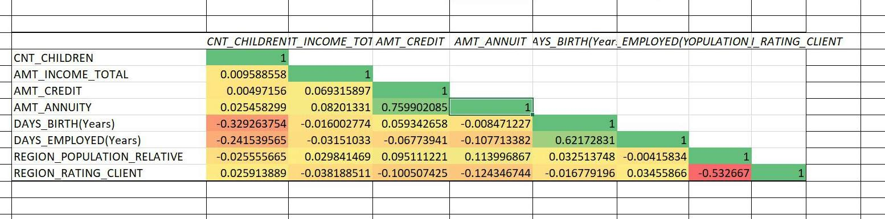

Slide 19
Tasks: Secondly on
Link for previous_application file

Slide 20
A. Identify Missing Data and Deal with it Appropriately: As a data analyst, you come across missing data in the loan application dataset. It is essential to handle missing data effectively to ensure the accuracy of the analysis.
Task: Identify the missing data in the dataset and decide on an appropriate method to deal with it using Excel built-in functions and features.

Slide 21
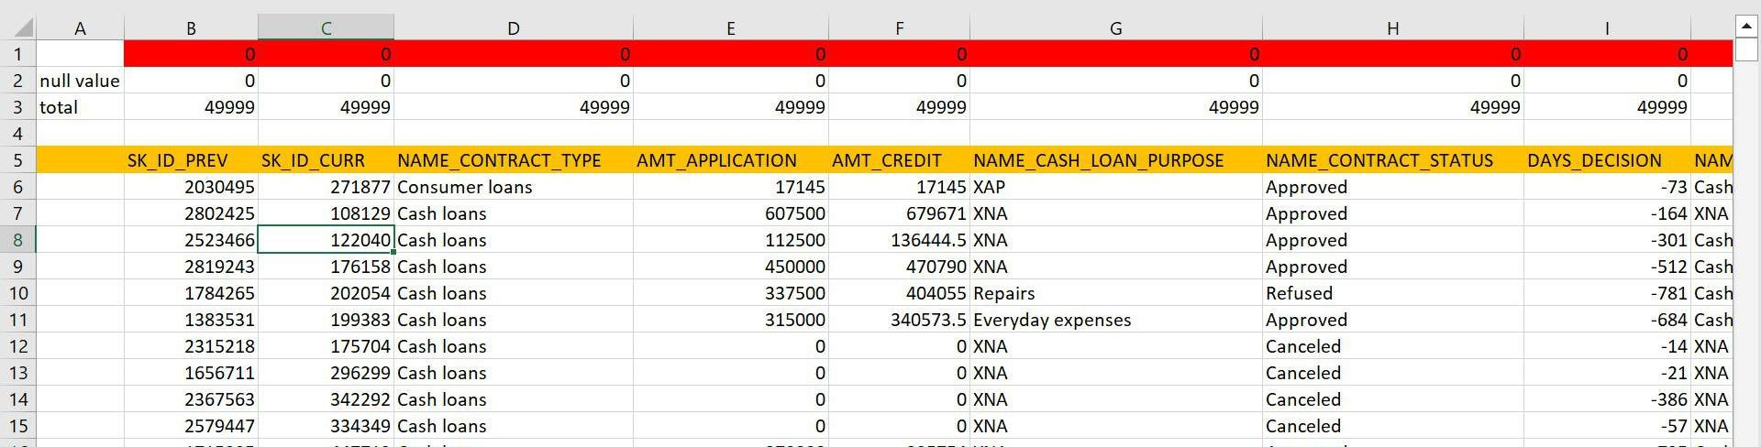
In this, I have removed all the columns which has null percent more than 20%. So there is no missing value left

Slide 22
B. Identify Outliers in the Dataset: Outliers can significantly impact the analysis and distort the results. You need to identify outliers in the loan application dataset.
Task: Detect and identify outliers in the dataset using Excel statistical functions and features, focusing on numerical variables.

Slide 23
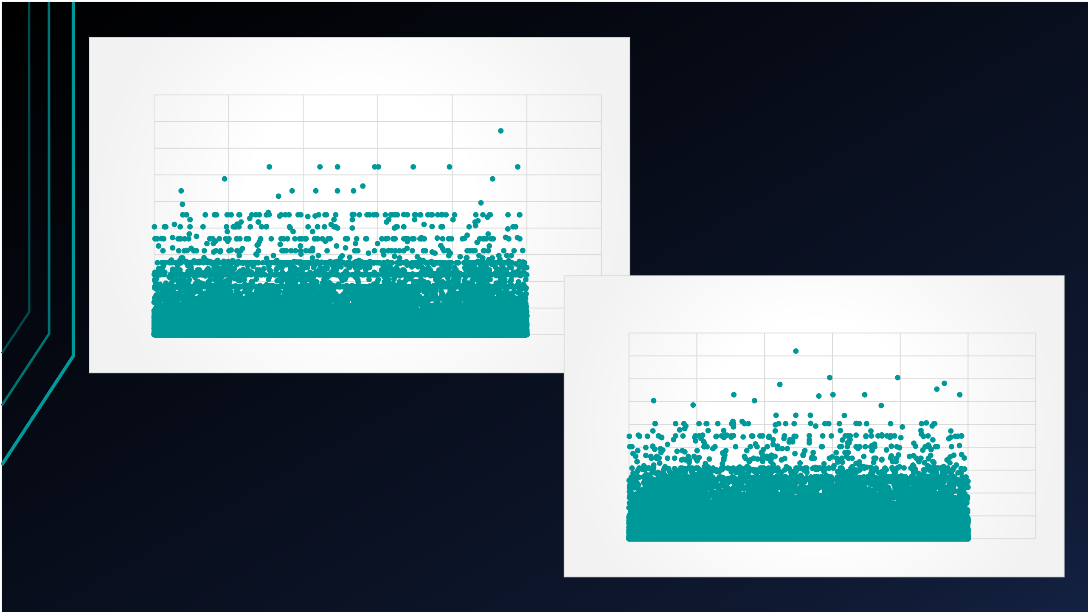
Outliers for AMT_CREDIT
 | Outliers for AMT_APPLICATION
4500000
4000000
3500000
3000000
2500000
2000000
1500000
1000000
500000
0 |  |  |  |  |  | 4500000
0 | 10000 | 20000 | 30000 | 40000 | 50000 | 40060000
 |  |  |  |  |  | 3500000
 |  |  |  |  |  | 3000000
 |  |  |  |  |  | 2500000
 |  |  |  |  |  | 2000000
 |  |  |  |  |  | 1500000
 |  |  |  |  |  | 1000000
 |  |  |  |  |  | 500000
 |  |  |  |  |  | 0
 |  |  |  |  |  |  | 0 | 10000 | 20000 | 30000 | 40000 | 50000 | 60000

Slide 24
C. Analyze Data Imbalance: Data imbalance can affect the accuracy of the analysis, especially for binary classification problems. Understanding the data distribution is crucial for building reliable models.
Task: Determine if there is data imbalance in the loan application dataset and calculate the ratio of data imbalance using Excel functions.

Slide 25
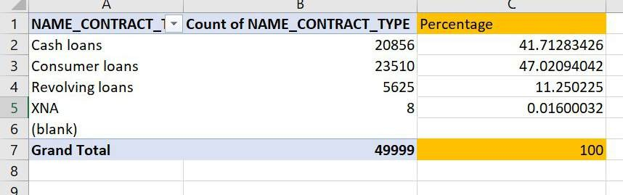




Total
25000
23510
20856
20000
15000
Total
10000
5625
5000
0
8
Cash loans
Consumer loans
Revolving loans
XNA
(blank)

Slide 26
D. Perform Univariate, Segmented Univariate, and Bivariate Analysis: To gain insights into the driving factors of loan default, it is important to conduct various analyses on consumer and loan attributes.
Task: Perform univariate analysis to understand the distribution of individual variables, segmented univariate analysis to compare variable distributions for different scenarios, and bivariate analysis to explore relationships between variables and the target variable using Excel functions and features.

Slide 27








Univariate analysis
Total
25000
23510
20856
20000
15000
Total
10000
5625
5000
Total
0
8
35000
30000
25000
20000
Cash loans
Consumer loans Revolving loans
XNA
(blank)
Total
15000
10000
5000
0
Approved
Canceled
Refused
Unused offer
(blank)

Slide 28

Segmented univariate analysis
25000
20000
15000
Cash loans Consumer loans Revolving loans XNA
(blank)
10000
5000
0
(blank)
0-500000
500000-1000000
1000000-
1500000
1500000-
2000000
2000000-
2500000
2500000-
3000000
3000000-
3500000
3500000-
4000000

Slide 29


Bivariate analysis
50000
45950
45000
40000
35000
30000
25000
16000
14000
12000
10000
8000
6000
4000
20000
Total
15000
10000
5000
2588
1149
171 123 9 8 1
high low_action low_normal middle
XNA
(blank)
0
(blank) 0-500000 500000- 1000000- 1500000- 2000000- 2500000- 3000000- 3500000-
1000000 1500000 2000000 2500000 3000000 3500000 4000000
2000
0
(blank)
0-500000
500000-1000000
1000000-1500000
1500000-2000000
2000000-2500000
2500000-3000000
3000000-3500000
3500000-4000000

Slide 30
E. Identify Top Correlations for Different Scenarios: Understanding the correlation between variables and the target variable can provide insights into strong indicators of loan default.
Task: Segment the dataset based on different scenarios (e.g., clients with payment difficulties and all other cases) and identify the top correlations for each segmented data using Excel functions.

Slide 31
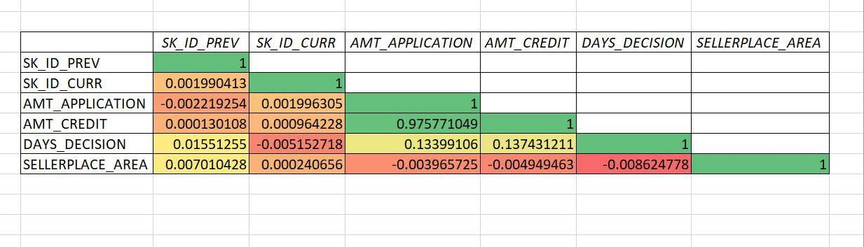

Slide 32
Thank You

